Slide 1


NEXT GEN EMPLOYABILITY PROGRAM
CREATING A FUTURE-READY WORKFORCE
Student Name :
UPPU VINAY KUMAR
Student ID :
College Name :
STU6560871fe5a411700824863
R.V.R&J.C COLLEGE OF ENGINEERING

Slide 2
CAPSTONE PROJECT SHOWCASE
Project Title
Note Sharing Web Application using Django Framework
Abstract | Problem Statement | Project Overview | Proposed Solution | Technology Used | Modelling & Results | Conclusion | Q&A

Slide 3
Abstract
1
Notes Sharing promotes engagement and interaction within learning communities, encouraging discussions and collaborations among peers.
2
It facilitates collaborative learning, knowledge dissemination, and academic or professional development.

Slide 4


Problem Statement
Project 10 : Build a Note Sharing Web Application using Django Framework (FSDW)

Slide 5

Project Overview
- Noteshare is a web app made with Django in Python, enabling easy sharing of resources between teachers and students in the same institution.
- It boasts a straightforward and user-friendly interface, ensuring users can easily access and utilize all of its features.

Slide 6
Proposed Solution
1. Text-based Notes Sharing: Create and share notes as text files via email, messaging apps, or cloud storage services.
2. Document Sharing Platforms: Use Google Docs or Microsoft Word Online to create and share notes collaboratively via shareable links.
3. Image-based Notes: Take pictures of handwritten or printed notes and share them directly or compile them into a PDF document.
4. Voice Notes: Record voice memos using a smartphone or computer and share them via messaging apps or email.
5. Online Note-taking Platforms: Utilize platforms like Evernote or OneNote for digital note-taking and easy sharing with collaborators.

Slide 7
Technology used
HTML (Hypertext Markup Language)
CSS (Cascading Style Sheet)
JavaScript
Python (Django)
SQL (Database)

Slide 8
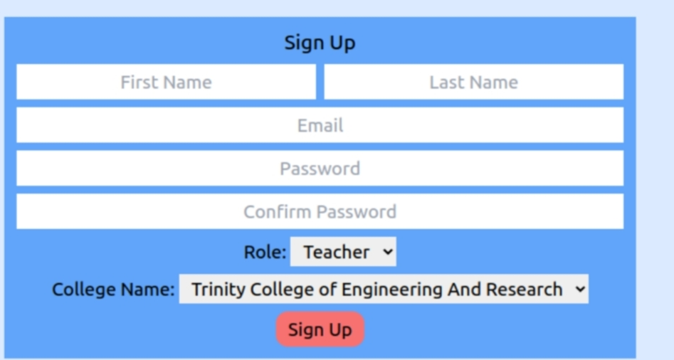
Modelling & Result

Slide 9
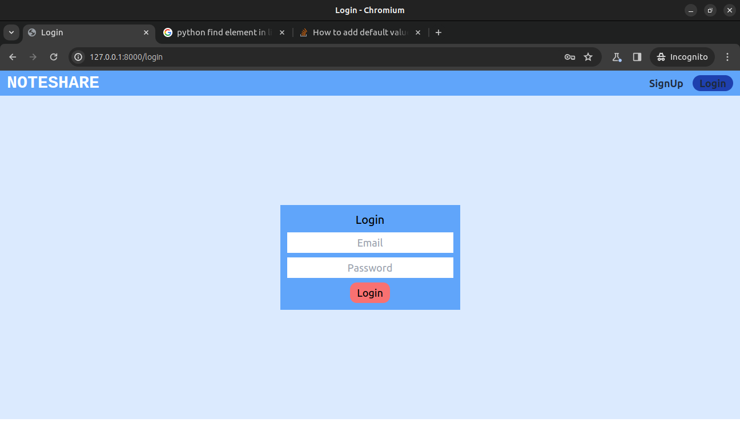
Modelling & Result

Slide 10
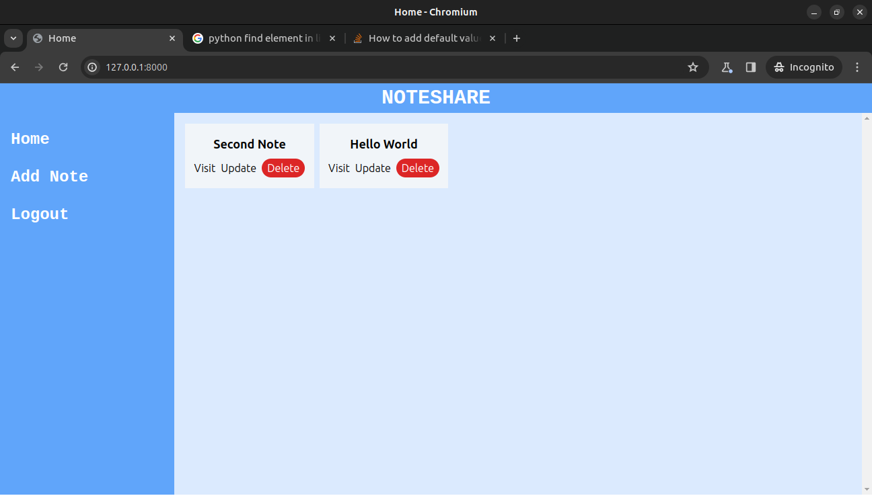
Modelling & Result

Slide 11
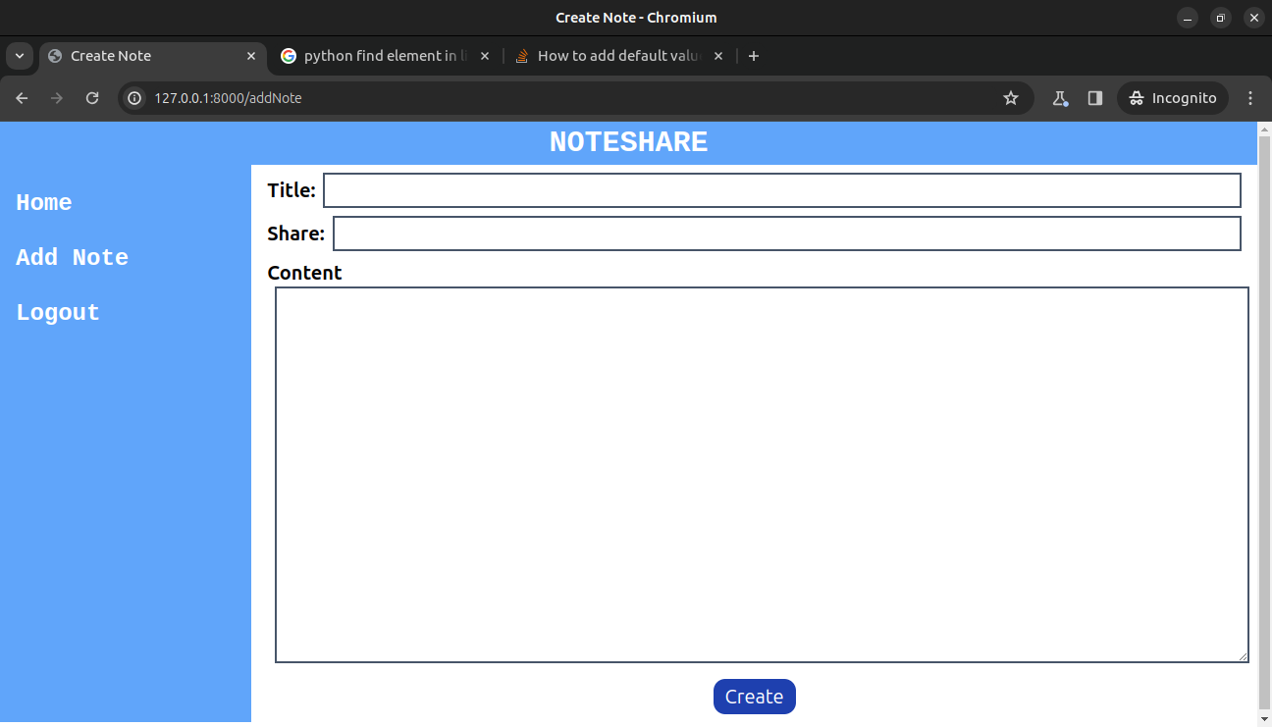
Modelling & Result

Slide 12
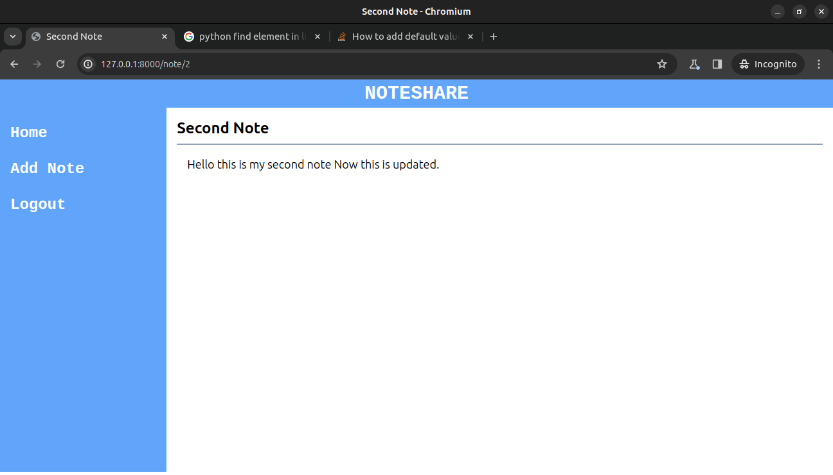
Modelling & Result

Slide 13

Conclusion
In summary, the notes sharing project offers simple ways for people to share their notes easily. By using methods like text-based notes, document sharing platforms, images, voice recordings, and online note-taking tools, users can choose the method that suits them best. These options make it convenient to share information with others, whether it's for work, study, or personal use. The project aims to make note sharing hassle-free and accessible to everyone.

Slide 14
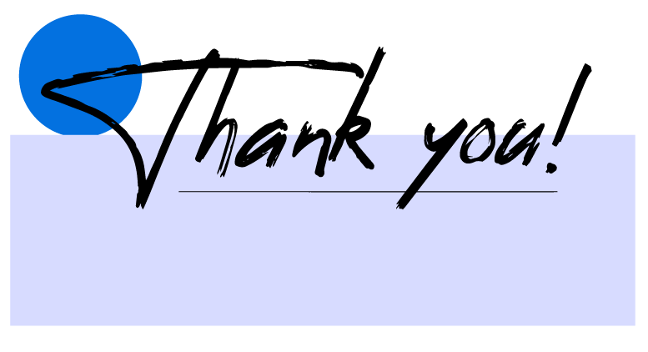

Notes:
Thank You !!

